Slide 1
DAINIUS BUDRYS
JSC “Rail Baltica statyba“ director
“Rail Baltica“project
in Lithuania
status and further steps
30 November, 2016

Slide 2
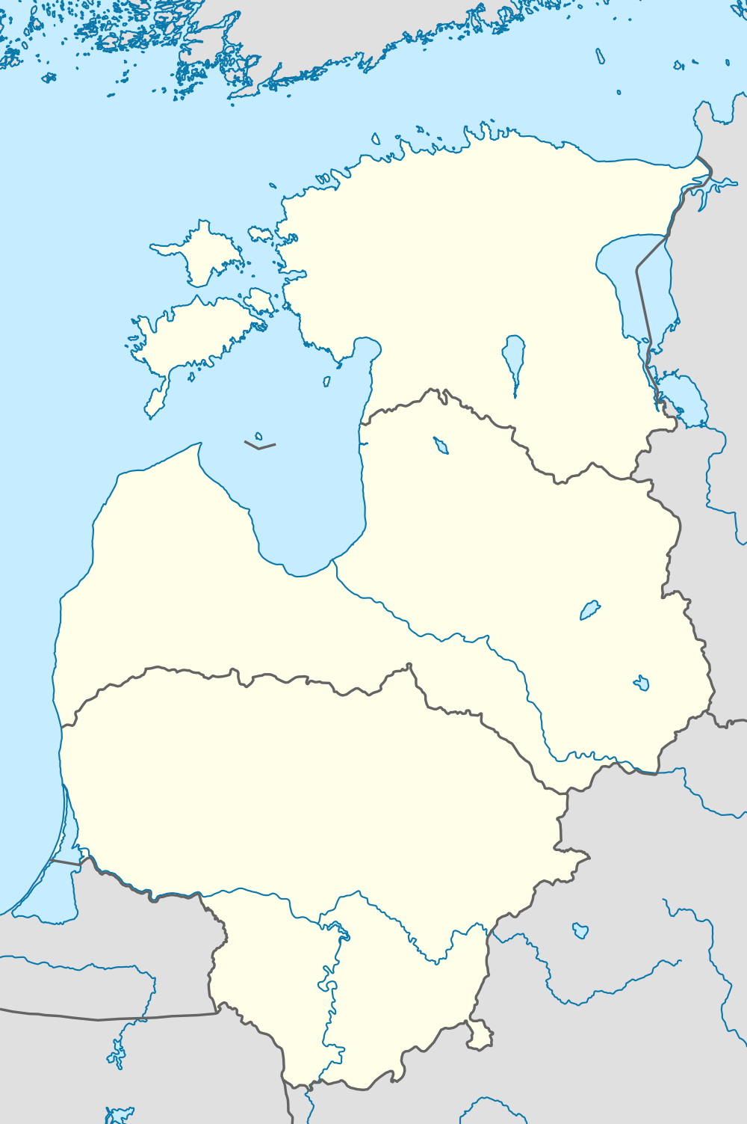
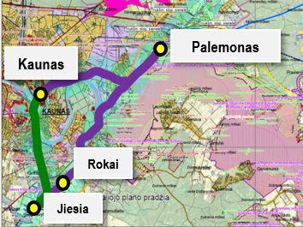
Rail Baltica project in Lithuania
(main sections based on CEF activity packages)
Kaunas (Palemonas) – Lithuanian/Latvian border
Kaunas
Missing links
(Jiesia-Rokai, Rokai-Palemonas, Kaunas-Palemonas)
Polish/Lithuanian border - Kaunas

Slide 3

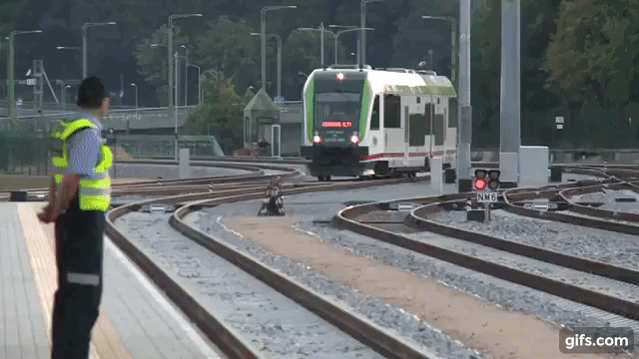
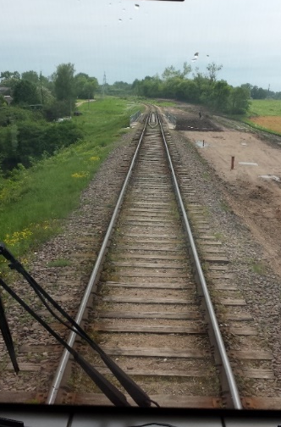
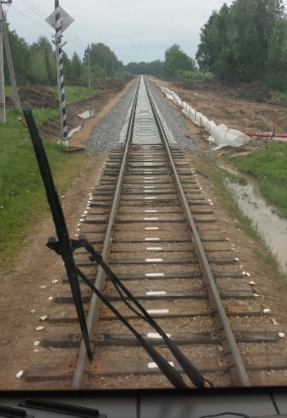
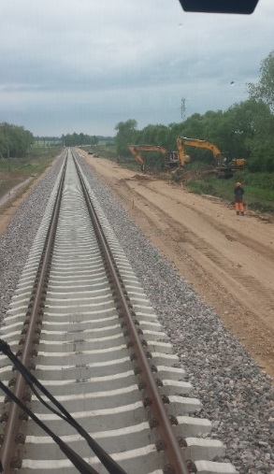


Section Polish/Lithuanian border-Kaunas
Construction works finished in 2015. As part of the works, 19 bridges, 4 viaducts, 108 switches, 40 crossings, 98 culverts, 10 railway stations and 20 platforms were constructed or reconstructed.
Total value of works – 301 million EUR (166 million EUR EU funding, 5 million EUR state budget, 130 million EUR JSC Lithuanian Railways).
Regular passenger service between Kaunas and Bialystok (286 km) launched in June 2016. Direct rail services from Lithuania to Poland opened for the first time in 77 years.
Level crossing signalling system was installed on the most traffic intensive road crossings to ensure traffic safety. As a result, travelling time in Lithuania had been shortened by 20 minutes (to 1 hour 40 minutes).
2013
2014
2015
2016
In addition to the study completed by Lithuanan railways, RB Rail will conduct a feasibility study in 2017 to reasure the feasibility of, and measures required to, upgrade the 1435 mm gauge railway line from Polish/Lithuanian border to Kaunas to achieve compliance with the Global Project standards.

Slide 4
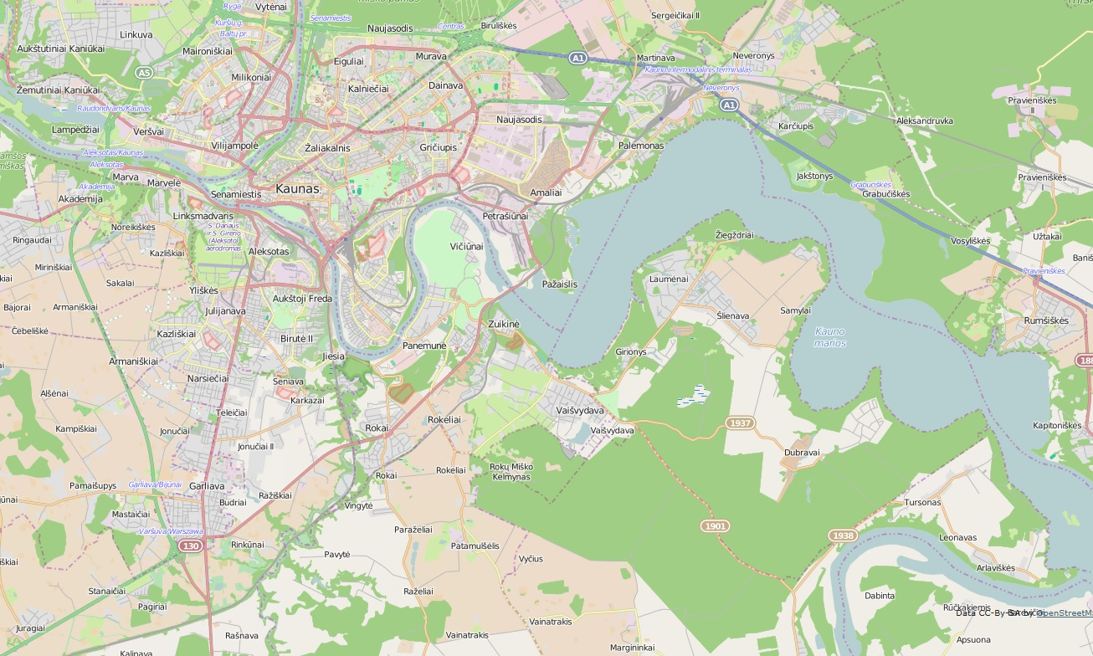
Missing links: Jiesia-Rokai, Rokai-Palemonas, Kaunas-Palemonas
Kaunas – Palemonas (10 km)
Public procurement ongoing: open tender for construction works was announced on 28/09/2016. Bids submitted.
Palemonas
Kaunas Public Logistic Center
(operational since 2015)
Kaunas
Kaunas
bypass
Rokai – Palemonas (8 km)
Public procurement ongoing: open tender for construction works was announced on
28/09/2016. Bids for different lots submitted.
Rokai
Jiesia
Jiesia – Rokai (5 km)
Contract signed on 07/10/2016.
to PL/LT border
Works on these sections will eliminate the bottleneck of the Rail Baltica axis

Slide 5

Section Kaunas-Lithuanian/Latvian border
Feasibility study
Completed
(AECOM, 2010-2011)
Special plan and environmental impact assessment
Ongoing
(AECOM, to be finished by the end of 2016)
Land expropriation
(2017-2018)
Technical design
(2018-2020)
Construction (Phase I-II)
(2019-2020)
Strategic environmental impact assessment
Completed
(Sweco, 2014)

Slide 6
Special plan and environmental impact assessment for the Kaunas-Lithuanian/Latvian border section
Summary:
Length - over 168 km;
Start point – Palemonas track yard;
Tracks – Double track.
Structures:
Bridges – 7;
Culverts – over 150;
Railway and automobile road viaducts – over 50;
Green bridges (overpasses) – more than 7;
Animal tunnels (underpasses) – more than 10.

Slide 7
Special plan and environmental impact assessment for the Kaunas-Lithuanian/Latvian border section
Publicity and Consideration procedures:
More than 2000 letters sent for publicity;
More than 1000 consultations provided by phone and emails;
More than 100 public advertisements published
in the newspapers & internet;
More than 20 public meetings organized;
More than 20 meetings with stakeholders (municipalities, ministries, ministry subsidiaries) organized;
More than 5 meetings with Latvian stakeholders (municipalities, ministries, ministry subsidiaries) organized.

Slide 8
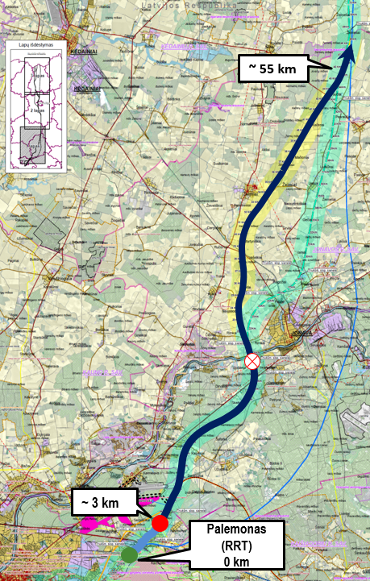
Section Kaunas-Lithuanian/Latvian border
2019-2020
Construction of the section Kaunas-LT/LV border (Phase II)
Construction of embankment (up to 55 km) and related infrastructure (bridges, viaducts, culverts, passings)
2019-2020
Construction of the section Kaunas-LT/LV border (Phase I)
Construction of approximately 2,9 km of railway line
Bridge over the river Neris is planned as a separate activity. Preliminary value - 50 million EUR.

Slide 9
Overview of CEF activities
- constructed
- designed
- expropriated land
- partly constructed
Land expropriation on the section Kaunas-LT/LV border
Technical design of the section Kaunas-LT/LV border
Construction of the section Kaunas-LT/LV border (Phase I and II)
172,4 million EUR (CEF – 146 million EUR)
Kaunas-Lithuanian/Latvian border
Project implementation support measures;
Owner’s supervision;
Communication with public;
Study activities.
6,5 million EUR
(CEF – 5,5 million EUR)
Missing links on the Kaunas node
Construction of the missing links on the Kaunas node (Jiesia-Rokai, Rokai-Palemonas, Kaunas-Palemonas)
108,5 million EUR (CEF – 92 million EUR)
Kaunas
Installation of signalling, traffic control, communications and related systems for the railway line of 1435 mm gauge in section “Polish and Lithuanian state border – Kaunas”
Preparation of technical documentation for the speed increase to 240 km/h in the section “Polish and Lithuanian state border – Kaunas”
Studies for the electrification on section “Polish and Lithuanian state border – Kaunas”
76,8 million EUR (CEF – 65,3 million EUR)
Polish/Lithuanian border-Kaunas

Slide 10
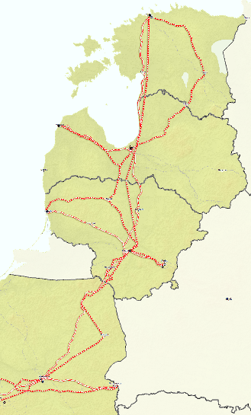



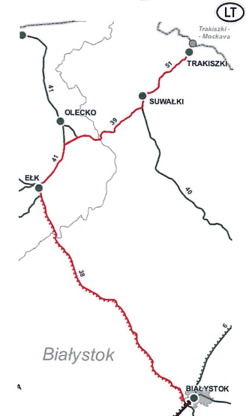

Rail Baltica in Poland
Works on line E75 Białystok-border with Lithuania (Trakiszki)
Rail Baltica railway
core line
Start of the construction works (foreseen) | 2019 (if funding is available) | 2019
Maximum speed | 100-120 km/h | 240 km/h

Slide 11
Thank you for your attention.

